Slide 1

ServiQue Platform
Final Project Presentation for INFO 5100
Abhinav Kumar Piyush, Aravind Balaji, Tanya Bansal.
Group 17
Group Project Members

Slide 2
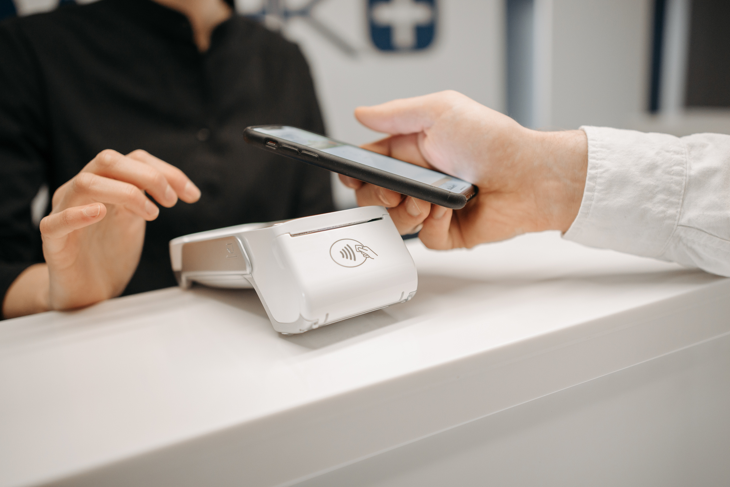



Problem Statement
Urban residents face difficulty finding trustworthy professionals.
Access to reliable services is often inconvenient and time-consuming.
Home and personal care services lack consistent quality and availability.
Personal care typically requires traveling to salons, which can be inconvenient due to long distances, time constraints, and scheduling issues.
For home services, contacting individual technicians or brand support is often tedious, lacking a streamlined system for appointments and availability.

Slide 3


Proposed Solution: ServiQue for Reliable Services
A unique platform utilizing Java Swing and DB4O for convenience.

Slide 4
“ServiQue” – as the name suggests is a SERVIce based uniQUE platform which is crafted designed to streamline the process of accessing reliable home and personal services.
By onboarding professionals across various domains, the platform manages the entire service lifecycle — from placing service requests to delivery and feedback — offering customers a seamless, end-to-end experience.
Built as a desktop application using Java Swing for the user interface and DB4O (Database for Objects)for backend data management, ServiQue ensures efficient and object-oriented handling of customer and service data.
Customers can conveniently browse services, place orders, and receive assistance — all from the comfort of their homes — eliminating the hassles of travel, coordination, and uncertainty.

Slide 5







Key Advantages of ServiQue
Convenient at-home access for customers and service providers:
ServiQue eliminates the need for users to physically visit salons or service centers by bringing a wide range of personal and home services directly to their doorstep through a single, user-friendly platform.
Streamlined Scheduling and Professional Onboarding:
With integrated scheduling and expert onboarding, users can easily book services at their preferred time, ensuring reliability, availability, and professionalism without the hassle of manual coordination.
Time Efficiency and Hassle-Free Experience:
By offering end-to-end service management — from request to fulfilment — ServiQue saves users time otherwise spent searching, calling, and waiting for technicians or appointments.

Slide 6






Enterprise Overview
Service Category
Service Provider
Service Quality
Equipment Warehouse
Various categories ensure users can find diverse services tailored to their needs.
Reliable providers are vetted to guarantee quality service for all customers.
Consistent monitoring ensures that all services maintain high standards of quality and reliability.
Seamless Inventory management in the Warehouse.

Slide 7


Roles Defined in ServiQue
The platform encompasses various roles for optimal service delivery.
System Admin manages the entire platform.
Enterprise Admins oversee individual service providers.
Customers request services through the application.
Supervisors ensure quality and performance standards.

Slide 8


Screenshots From the Project

Slide 14


Thank You!
Join us in revolutionizing service access!

